Slide 1

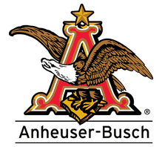

Budweiser craft brewery eda Michael Burgess Rob Pollock

Slide 2
Background Information
Asked by the CEO and CFO to explore 2 data sets regarding craft breweries and beers in the United States
2,410 Beers
558 Breweries
Data includes information on:
The name and location of the Brewery (City and State)
The name, alcohol content, style, and bitterness of the beers in the dataset
Alcohol content is measured in ABV and will be referred to as ABV
Bitterness is measured in IBU and will be referred to as IBU

Slide 3
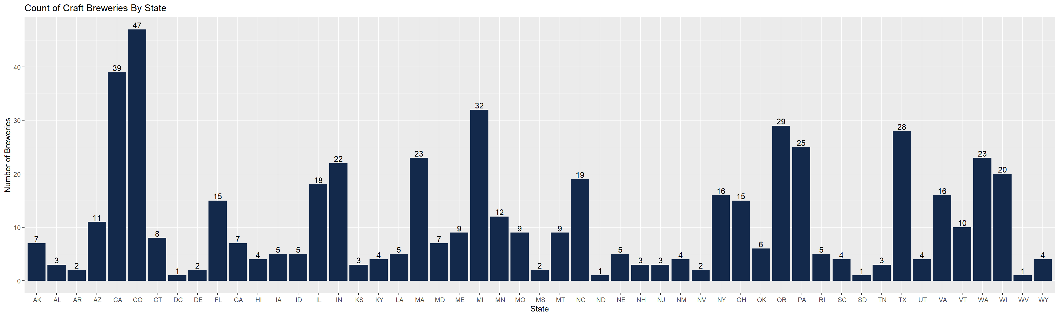
Number of Craft Breweries By State
We plotted how many breweries were present in each state out of the 558 total breweries we had data for:

Slide 4
Number of craft breweries by state
This table sorts the states by most to least number of craft breweries
State | Number of Breweries | State | Number of Breweries
CO | 47 | WY | 4
CA | 39 | AL | 3
MI | 32 | KS | 3
OR | 29 | NH | 3
TX | 28 | NJ | 3
PA | 25 | TN | 3
MA | 23 | AR | 2
WA | 23 | DE | 2
IN | 22 | MS | 2
WI | 20 | NV | 2
NC | 19 | DC | 1
IL | 18 | ND | 1
NY | 16 | SD | 1
VA | 16 | WV | 1
FL | 15
OH | 15
MN | 12
AZ | 11
VT | 10
ME | 9
MO | 9
MT | 9
CT | 8
AK | 7
GA | 7
MD | 7
OK | 6
IA | 5
ID | 5
LA | 5
NE | 5
RI | 5
HI | 4
KY | 4
NM | 4
SC | 4
UT | 4

Slide 5
Issues with Missing Data
Summary of missing data:
Brewery Data Set: No missing data noted (no “NA’s”)
Beer Data Set: 62 (2.5%) ABV Values &1005 (42%) IBU Values Missing
The beer and brewery data sets were joined using a left join on the Brewery_id in the beer file and the Brew_ID column in the breweries file. No missing values were created as a result of this join and this allowed us to match each beer to the brewery that produced it.
The missing ABV and IBU values were present in the beer data file from the beginning.
The missing values were replaced with the mean ABV and IBU for each beer style.
After this replacement process there were no missing values for ABV and only 52 (2.16%) missing values for IBU.
The missing IBU values were either in very small amounts, 1 or 2 beers, or belonged to very sweet styles of beer such as ciders. We felt comfortable omitting these beers from our analysis.
While there did not appear to be outliers skewing the mean, the mean must be used with caution. Extreme values can pull the mean in one direction or the other.

Slide 6
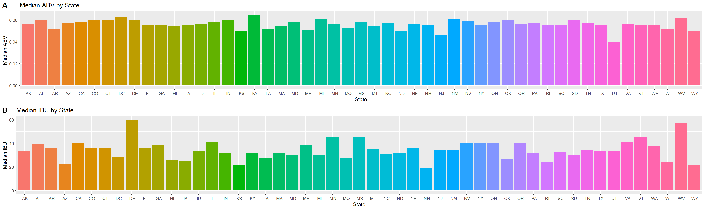
Median ABV and IBU by State
The following charts show the median (middle) ABV and IBU across all beer styles for each state

Slide 7
Maximum abv and ibu
Looking across all beer styles we found the following beers that represented the maximum ABV and maximum IBU value
The beer with the maximum ABV at 12.8%:
Lee Hill Series Vol. 5 – Belgian Style Quadrupel Ale
Quadrupel (Quad)
Upslope Brewing Company Boulder, CO
The beer with the maximum IBV at 138:
Bitter Bitch Imperial IPA
American Double / Imperial IPA
Astoria Brewing Company Astoria,OR

Slide 8
Summary Statics FOR ABV
We next explored some summary statistics for ABV across all beer styles:
The minimum ABV found was 0.1%
The maximum ABV found was 12.8%
The median ABV was 5.6%
The mean ABV was 5.98%
Most beers fall between 5% and 6.7% ABV
Min | 1st Qu. | Median | Mean | 3rd Qu. | Max | NA # | Std Dev
0.0010 | 0.05 | 0.056 | 0.05977 | 0.67 | .128 | 62 | 0.0135

Slide 9
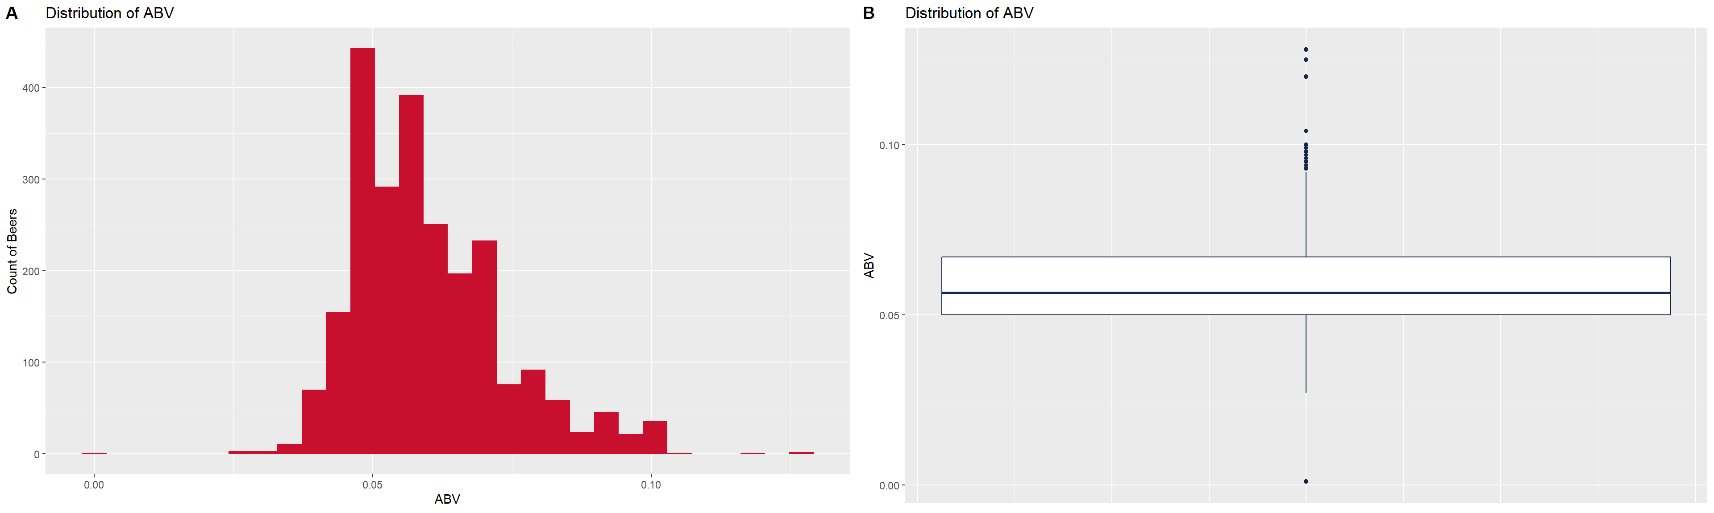
distribution of Abv across all beers
These plots show the distribution of ABV for all beer styles. Again, we see the majority of beers falling between 5% – 6.7% ABV
The boxplot shows us where our median ABV falls as well as showing other useful information such as outliers

Slide 10
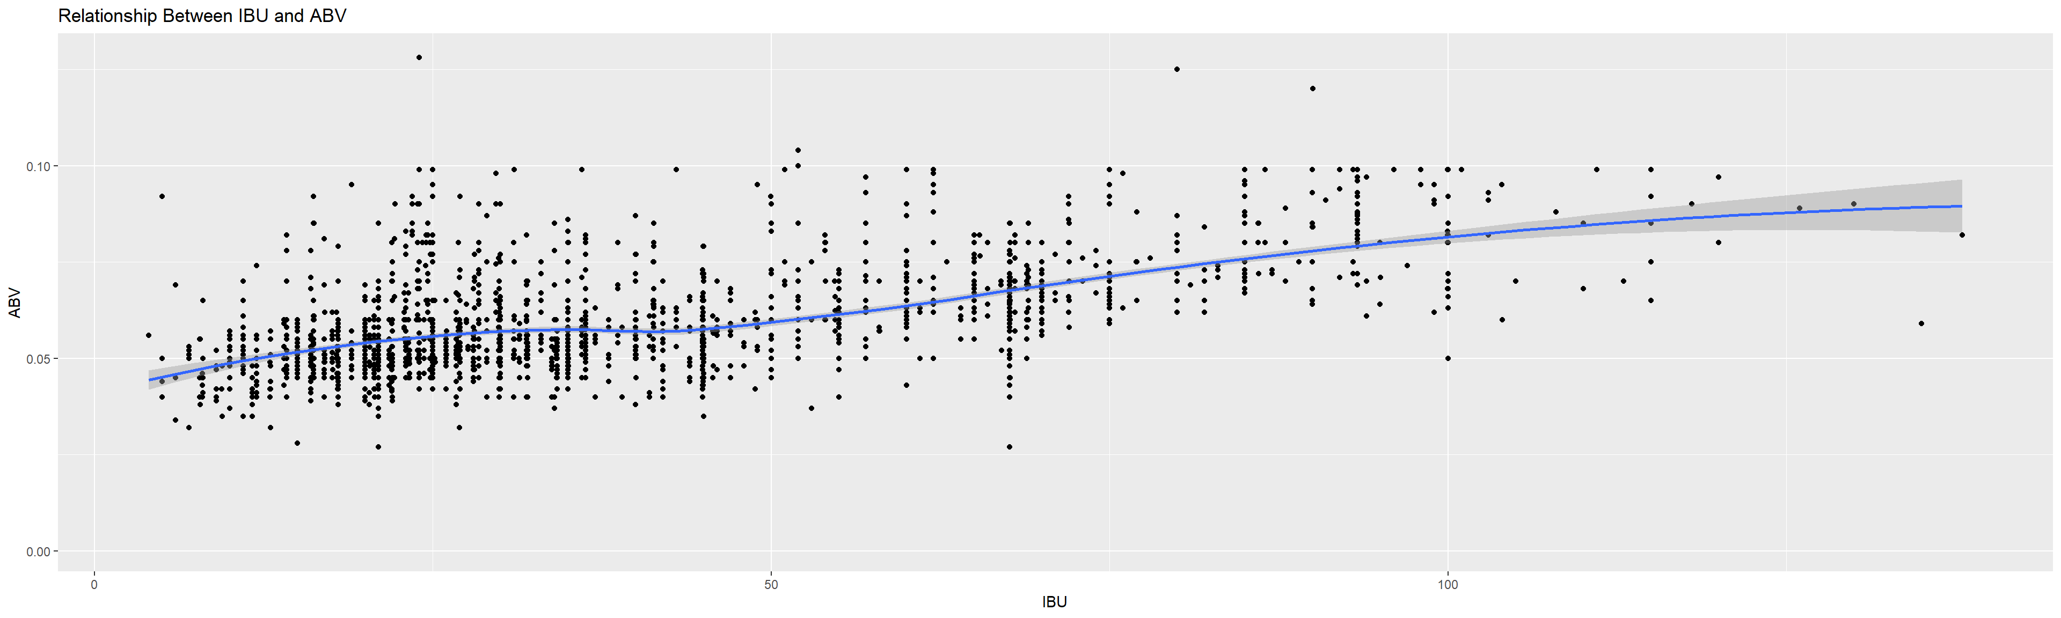
relationship between abv and ibu
It appears that there is little to no correlation between IBU and ABV:
For beers between roughly 0 and 25 IBU we see a gradual increase in the ABV
At 25 to 50 IBU the trend stays relatively consistent with ABV close to 5%
There is a stronger linear trend between 50 and 100 IBU with ABV increasing consistently
Over 100 IBU the relationship is fairly flat again

Slide 11
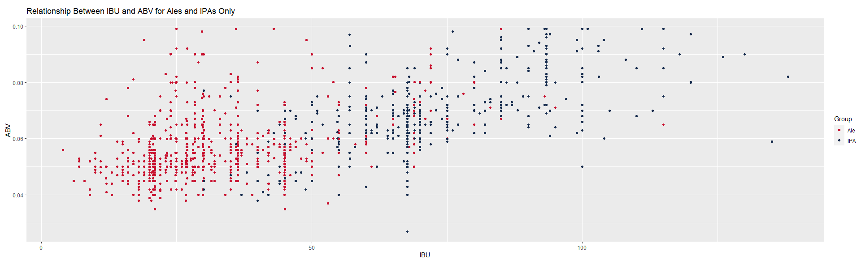
using abv and ibu to predict beer type
k-Nearest Neighbors (kNN) allows us to use the existing data to predict whether a beer is an IPA or an ale
We split the data set into training and test sets
70% of the data in the training set
30% in the test set
We use ABV and IBU to plot the data in the training set and then we plot a data point for each beer in the test set using its unique ABV and IBU values
We compare the test point to so many of its neighbors. The number of neighbors is k and we define this value to adjust our accuracy.
Majority rules and classification is determined by the group that has the most data points in our group of k number of neighbors

Slide 12
using abv and ibu to predict beer type
We found that k = 5 gave us the best accuracy and that accuracy quickly trailed off for larger values of k
To eliminate extreme values for the accuracy of our model, we ran the kNN test 100 times using different random samples of the data to produce different tests each time.
We then took the mean values for accuracy, sensitivity, and specificity across all 100 tests.
Using k = 5 we were able to predict whether a beer in the test set was an ale or an IPA with a mean accuracy of about 91%. That is to say, the model identified 91% of the 473 test beers correctly.
The model showed a mean sensitivity of approximately 92%. This means that it identified 92% of the ales as ales.
The model showed a mean specificity of approximately 87%. This means that it was able to identify 87% of the IPAs as IPAs.

Slide 13
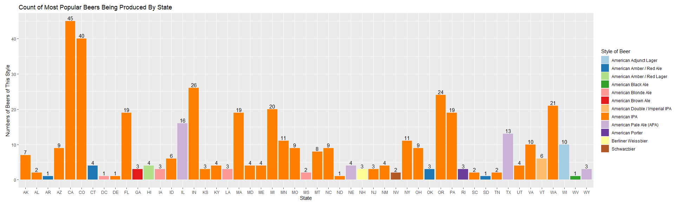
Additional insights
We were also asked to look at an additional insight that the data might provide
We choose to plot the top beer produced for each state and how many of that style of beer were in our data set
This information can be used to determine whether Budweiser wants to compete in a crowded segment for any given market or if they may want to look for alternative options

Slide 14
In summary
Given 2 data sets with 2,410 beers and 558 breweries
We joined this data together using the Brewery_ID field and replaced the missing ABV and IBU values with the mean for each style of beer
We plotted how many breweries exist in each state
We showed the median ABV and IBU values across all beers for each state
Colorado makes the strongest ABV beer at 12.8% and Oregon produces the highest IBU beer at 138.
We provided statistics about the ABV value and how it is distributed across all beers. Most beers fall in the 5% to 6.7% ABV range.
We showed a weak correlation between IBU and ABV. The relationship is stronger for beers between 0 and 25 IBU and 50 to 100 IB.
With kNN we were able to correctly identify 91% of beers as ales or IPAs with k = 5
We also provided a graphic showing the most popular beer style for each state and how many of those beers are being produced in each state

Slide 15
Thank you for your time Michael Burgess Rob Pollock

